Slide 1
Employee Data Analysis using Excel
STUDENT NAME: C.SANDHIYA
REGISTER NO:122203096
DEPARTMENT:B.COM(CORPORATE SECRETARYSHIP)
COLLEGE: MAHALASHMI WOMENS COLLEGE ARTS AND SCIENCE

Slide 2
PROJECT TITLE
Employee Performance Analysis using Excel

Slide 3


AGENDA
Problem Statement
Project Overview
End Users
Our Solution and Proposition
Dataset Description
Modelling Approach
Results and Discussion
Conclusion
3/21/2024 Annual Review

Slide 4

PROBLEM STATEMENT
"The current [system/process] is [briefly describe the issue], resulting in [specific problem or challenge]. This leads to [undesirable consequences] and impacts [stakeholders]. How might we [desired outcome], to improve [specific aspect] and achieve [benefits]?"
Feel free to customize it to fit your specific needs!

Slide 5

PROJECT OVERVIEW
"This project aims to [briefly describe the project's goal], addressing [specific problem or opportunity]. It will [key objectives] and deliver [desired outcomes], utilizing [methods/technologies]. The expected benefits include [benefits] and [impact], aligning with [organizational/strategic goals]."
Let me know if you'd like me to customize it for your project!
.

Slide 6

WHO ARE THE END USERS?
1.IT COMPANY
2. BANKS
3.MARKETING FIELD
4. INDUSTRY

Slide 7

OUR SOLUTION AND ITS VALUE PROPOSITION
1. CONDITIONAL FORMATTING
2.FILTERING
3.PIVOT TABLE FOR SUMMERISING
4.BAR GRAPH
5. Pie chart

Slide 8
Dataset Description
1. Employee data downloaded from edunet dashboard.
2. Featured:
Totally 26 features were available in that 4 were considered
3. General code.
4. First name.
5. Business unit.
6. Performance level.

Slide 9

THE "WOW" IN OUR SOLUTION
=ifs(K2>=5,"very high",K2>=4,"high",K2>=3,"medium",true,"low")
3/21/2024 Annual Review
9

Slide 10
MODELLING
1. SUMMERISING:
Pivot table is created to summerise
2. Filter - Gender code
3. Column- performance level
4. Rows - Business unit
5.values- count of first name
6. Visualisation:
Bar graph
Pie chart
10

Slide 11
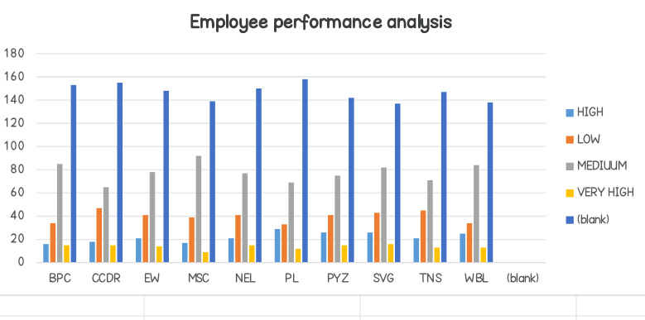
RESULTS
11

Slide 12
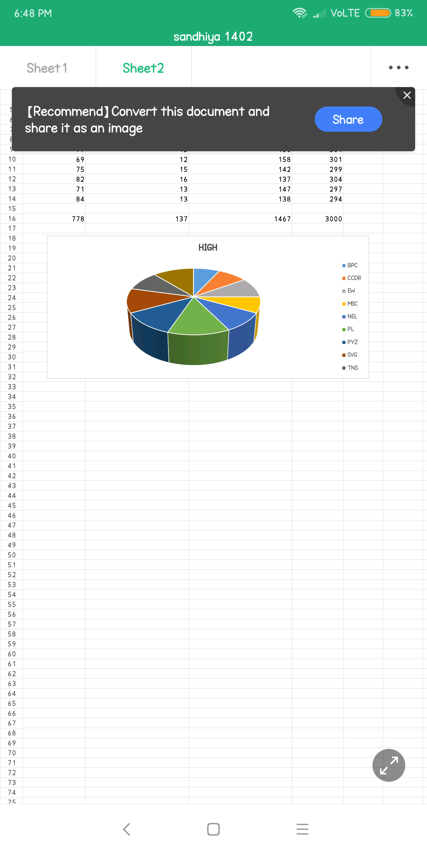
RESULTS

Slide 13
conclusion
Therefore the SVG business unit employees performs higher comparing to other units and whereas PL business unit performs lower comparing to other units. Hence the SVG business unit employees works more efficiently and effectively comparing to other units according to the employee data given.

